Slide 1

CONTROL OF CYBERBULLYING USING SEMANTIC-ENHANCED MARGINALIZED DENOISING AUTO-ENCODER
Batch No: 17
Project Team Members:
Lavanya K [1AY14IS050]
Medha N Gudihal [1AY14IS056]
Megha V [1AY14IS057]
Sheethal H S [1AY14IS095]
Under the guidance of
Prof. Sushma T M Information Science And Engineering Acharya Institute of Technology

Slide 2
AGENDA
Abstract
Introduction
Literature Survey
Implementation
Testing
Applications
1
7
2
8
3
9
Problem Statement
Design
Requirements
Conclusion
Future Enhancements
References
4
10
5
11
6
12
2

Slide 3
ABSTRACT
With the advent of social media networks such as Facebook and Twitter, cyberbullying has become more prevalent.
Implication of cyberbullying becomes serious when the victims fail to cope with emotional strain from abusive, threatening, humiliating and aggressive messages.
Machine learning techniques make automatic detection of bullying messages in social media possible, and this could help to construct a healthy and safe social media environment. We use a representation learning method named Semantic-Enhanced Marginalized Denoising Auto-Encoder (smSDA).
We will be able to exploit the hidden feature structure of bullying information.
Also the system will be able to block the post which contains bullying words and it will also block the user with a history of constant or repetitive bullying temporarily on online social network.

Slide 4

INTRODUCTION
What is Cyberbullying? It is defined as an aggressive, intentional act carried out by a group or individual, using electronic forms of contact, repeatedly and over time, against a victim who cannot easily defend him or herself .
Examples of cyberbullying include mean text messages or emails, rumours sent by email or posted on social networking sites, and embarrassing pictures, videos, websites or fake profiles.
Deep learning is a subfield of machine learning concerned with algorithms inspired by the structure and function of the brain called artificial neural networks.
We use the semantic extension of the popular deep learning model stacked denoising autoencoder (smSDA).
4

Slide 5

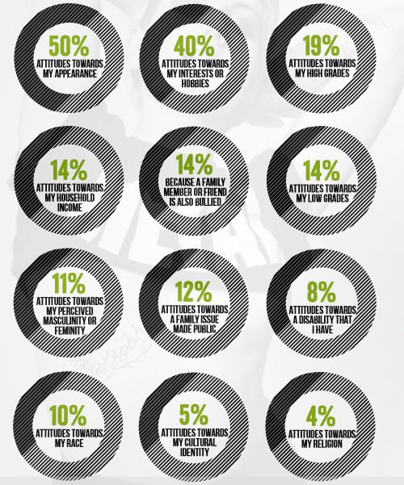

WHY ARE PEOPLE BULLIED?
5

Slide 6
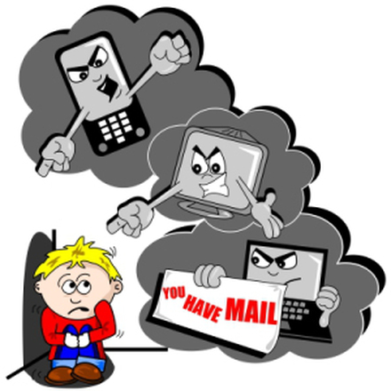
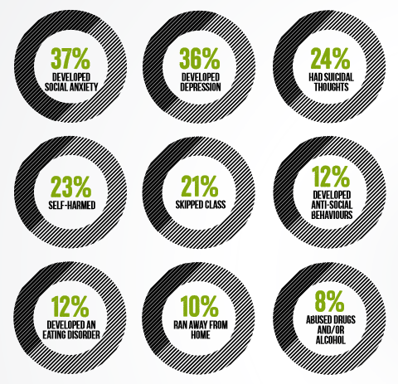

WHAT IS ITS IMPACT?
6

Slide 7
LITERATURE SURVEY
SL no | Title of the Paper | Journal Published | Author | Problem Addressed | Authors Approach / Method | Results
1 | Detection based on Semantic-Enhanced Marginalized Denoising Auto-Encoder. | International Journal of Scientific Research in Computer Science, Engineering and Information Technology, 2017. | G Netaji | Cyber Bullying | Semantic -Enhanced Marginalized Denoising Auto-Encoder (smSDA) | The performance of our approaches has been experimentally verified through 2 cyberbullying corpora from social medias: Twitter and MySpace
2 | An effective approach for cyberbullying detection. | Communications in Information Science and Management Engineering, 2012. | V Nahar | Cyber Bullying | Weighted TF-IDF, LDA Algorithm, HITS Algorithm and GraphModel. | Cyber Bullying detection and identification of the most active predators and victims.
7

Slide 8
SL no | Title of the Paper | Journal Published | Author | Problem Addressed | Authors Approach / Method | Results
3 | Modelling the detection of textual cyberbullying. | The Social Mobile Web, 2011. | K Dinakar | Cyber Bullying | Naïve Bayes classifier, JRip, J48, TF-IDF. | Detecting textual cyberbullying in stand-alone posts with a dataset of YouTube comments.
4 | Detection of harassment on web 2.0. | Proceedings of the Content Analysis in the WEB, vol. 2, pp. 1–7, 2009. | D. Yin | Online Harassment and Misbehavior. | Term Frequency/Inverse Document Frequency (TF-IDF) | The approach combines local features, sentiment features, and contextual features to train a model for detecting harassing posts in chat rooms and discussion forums.
8

Slide 9
PROBLEM STATEMENT
“ To implement a safe and secure online social network that is free from textual based cyberbullying. Not just when there are direct bullying words but also when there are hidden features in it and thereby blocking such posts. On repetitive bullying the user is blocked permanently. ”
9

Slide 10


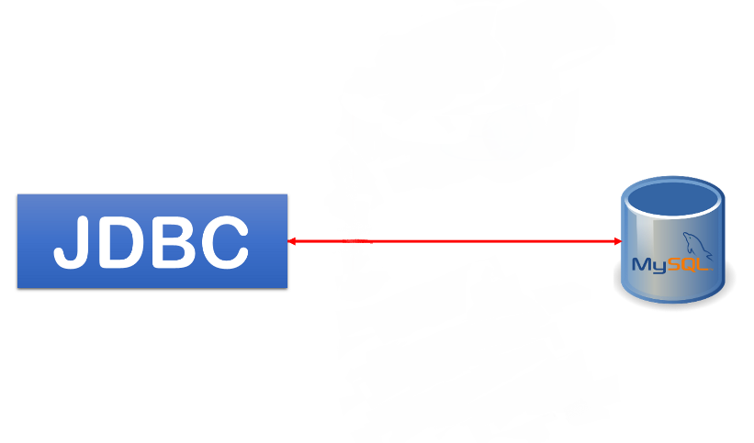


REQUIREMENT SPECIFICATION
Software requirements:
MySQL Database
Apache Server
Java (jdk 1.8 version)
JDBC (Java Database Connectivity)
PHP (Hypertext Pre-processor)
NetBeans IDE (Version 8.0.1)
10

Slide 11
DESIGN
1. DATA FLOW DIAGRAM:
The DFDs below shows how the information moves through the system and how it is modified by a series of transformations.
USER login
ADMIN LOGIN
Yes
Check
No
Unauthorized user
Yes
Check
No
Unauthorized
View profile
Send friend request
User List
Share photos on timeline
Find abnormal user
Send Private and public message
Block bullying post
View friend list
End process
End process
Data flow diagram for user activities
Data flow diagram for admin activities
11

Slide 12
2. USE CASE DIAGRAM:
This use case diagram shows what system functions are performed by the actors-user and admin.
Login
Registration
View Profile
Find Friends
Share photo on timeline
Send Request
Admin
User
View request
View message
Send message
Search friends
Find abnormal user
Block Cyberbullying Words
Use Case Diagram for Users and Admin
12

Slide 13
3. CLASS DIAGRAM:
The class diagram shows the classes and their class specific functions.
USER
ADMIN
Login
Login
View profile ()
Find friends ()
Share photos on timeline ()
Send request and view request ()
Send message and view message ()
Public post ()
Private chat ()
Public chat ()
Find abnormal user ()
Find Cyberbullying user ()
REGISTRATION
User name
Password
Email
Profile images
User Details
Class diagram for user, admin and registrations
13

Slide 14
4. SEQUENCE DIAGRAM:
This sequence diagram shows how processes operate with one another and in what order.
OSN
ADMIN
USER
Create Account
Public and private message
View profile, find friends, share photos on timeline, view friend requests and send messages.
Find abnormal user and Cyberbullying user
DATA BASE
Sequence diagram for user, admin and registrations
14

Slide 15
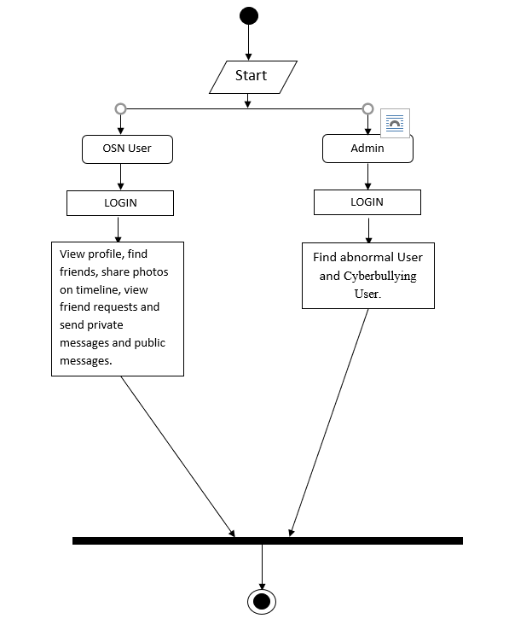
5. ACTIVITY DIAGRAM:
This activity diagram describes the operational step-by-step workflows of components in the system. It shows the overall flow of control.
Activity diagram for user and admin
15

Slide 16
IMPLEMENTATION
MODULES
OSN System Construction Module:
In the first module, we develop the Online Social Networking (OSN) system module. · This module is used for new user registrations after which the users can login, existing users can send messages privately and publicly, share posts, accept and send friend requests.
16

Slide 17
1.Construction of OSN:
Procedure Construction_of_OSN (User and admin)
Input: n users and admin
Output: Basic OSN
Begin
Step1: Create the web application with basic features of a social media.
Step2: User should be able to register, login and send/accept friend requests.
Step3: User can post messages on their walls and their friend’s walls as well.
Step4: Store all the user information.
End
17

Slide 18
B. Construction of Bullying Feature Set:
The bullying features play an important role and should be chosen properly. In this module, we build a list of words with negative affective, including swear words and dirty words. Then, we compare the word list with the BoW features of our own corpus and regard the intersections as bullying features.

Slide 19
2.Construction of bullying features:
Procedure Construction_of_bullying features(Bow, Dict)
Input: Bag of words (BOW) and dict
Output: Construction of bullying features
Begin
Step1: Add the bullying words to our own corpus with word embedding technique.
Step2: Assign the weights to the words.
Step3: Find the intersection between BoW and bullying dictionary.
i)if words intersect then add into the bullying features
ii)else repeat step2
End
19

Slide 20
C. Cyberbullying Detection:
In this module, we propose the Semantic-enhanced Marginalized Stacked Denoising Auto-encoder (smSDA) for cyberbullying detection.
D. Semantic-Enhanced Marginalized Denoising Auto-Encoder:
During training of smSDA, we attempt to reconstruct bullying features from other normal words by discovering the correlation between bullying and normal words to detect the bullying messages.
20

Slide 21
3. smSDA:
Procedure smSDA (corrupted words, bullying features)
Input: corrupted words, bullying features
Output: Reconstruction of corrupted words and block the bullying messages.
Begin
Step1: Read corrupted words.
Step2: Find the co-relation between the corrupted words and normal words.
Step3: Reconstruct the corrupted words.
Step4: Detect if the reconstructed word is bullying word or normal word.
Step5: if it is a bullying word
Block the post
else
Post the message on the user’s wall
End
21

Slide 22
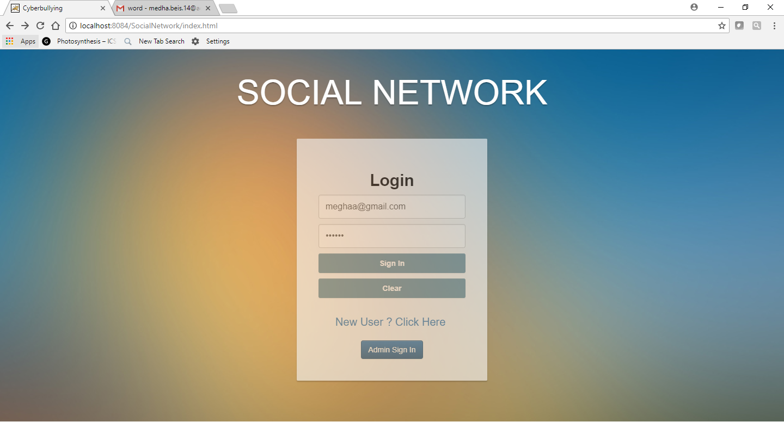
SNAPSHOTS
LOGIN PAGE
22

Slide 23
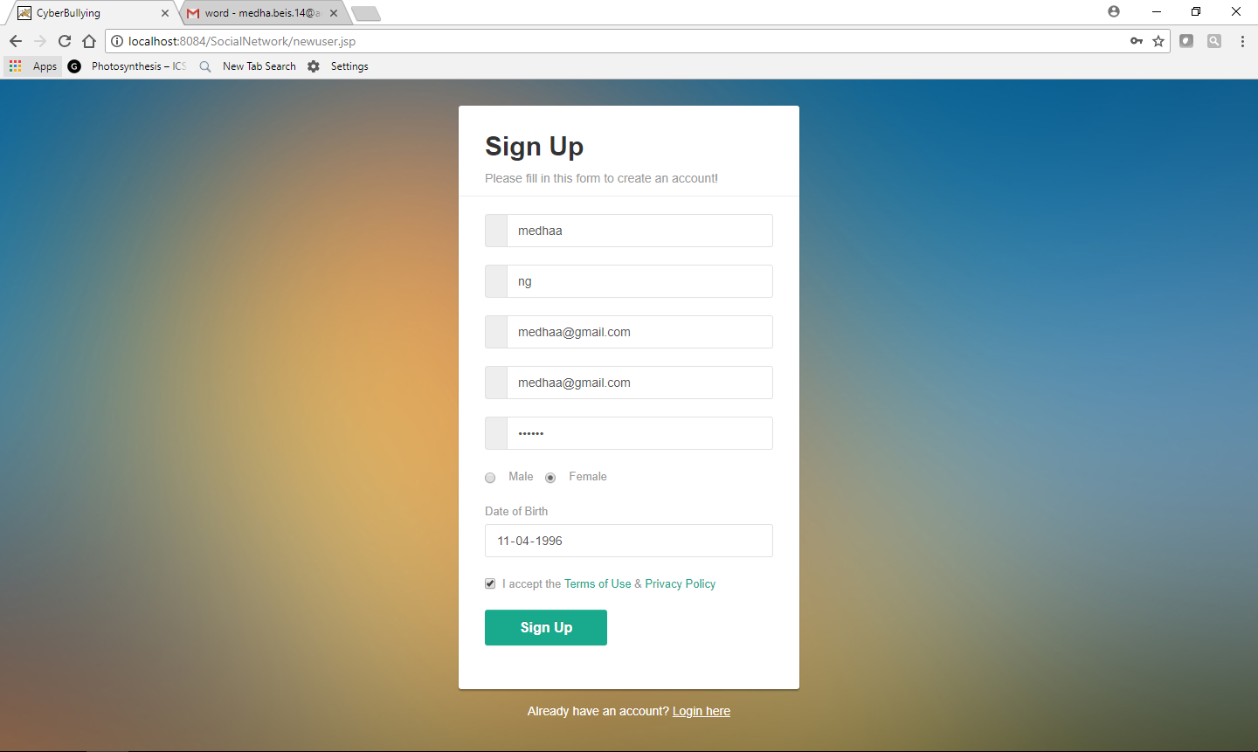
NEW USER SIGNUP
23

Slide 24
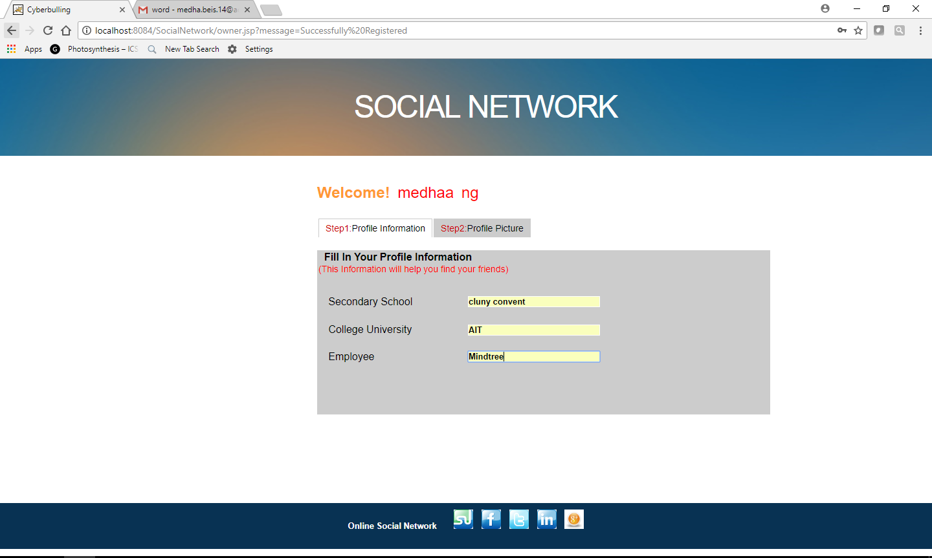
ADD PROFILE INFORMATION
24

Slide 25
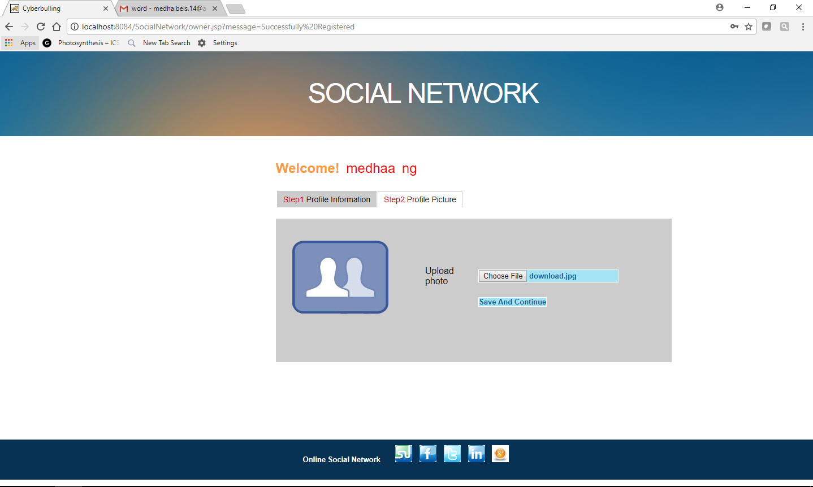
ADD PROFILE PICTURE
25

Slide 26
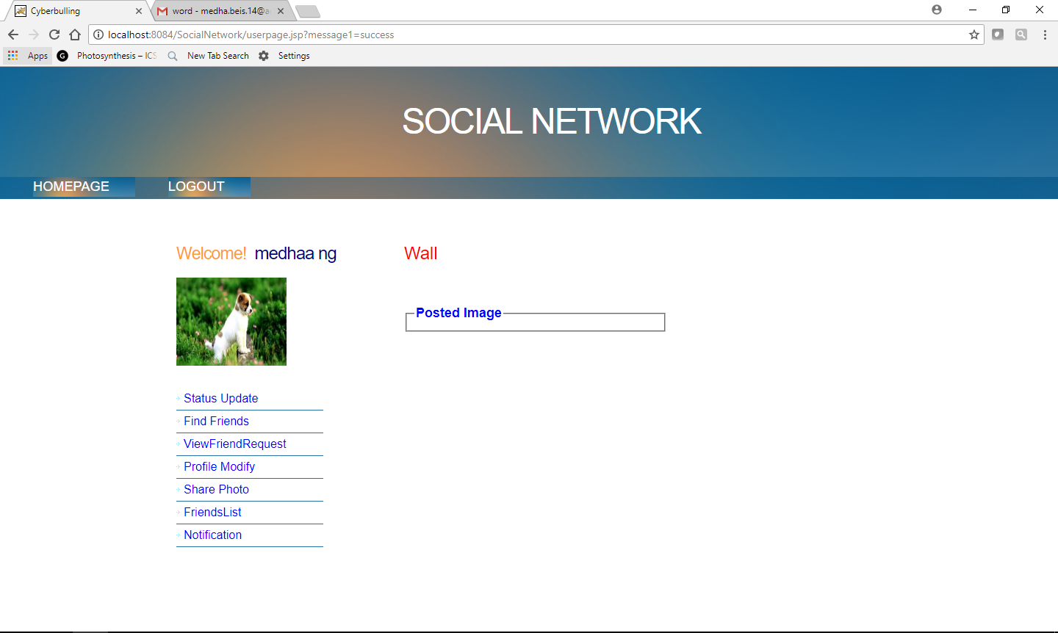
USER PAGE
26

Slide 27
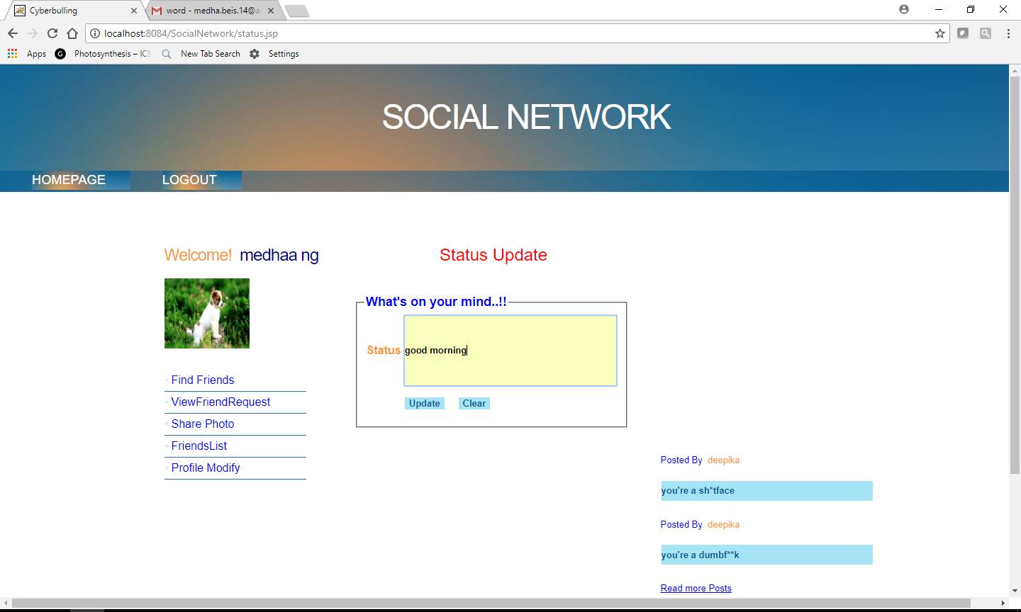
STATUS UPDATE
27

Slide 28
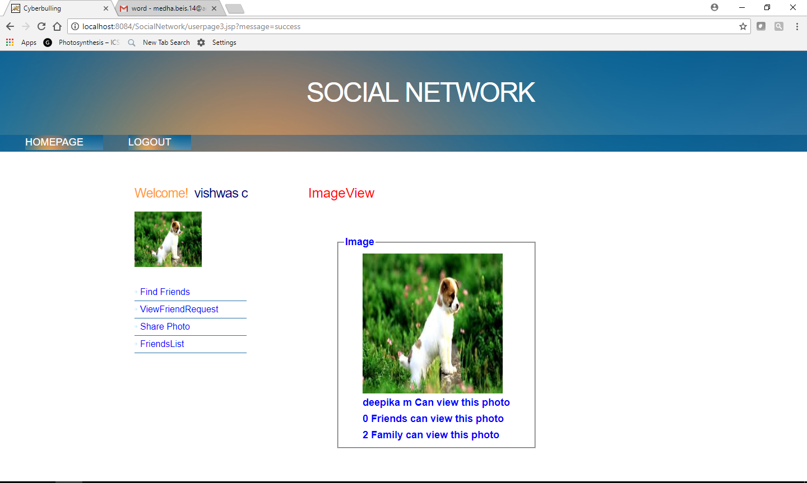
IMAGE VIEW
28

Slide 29
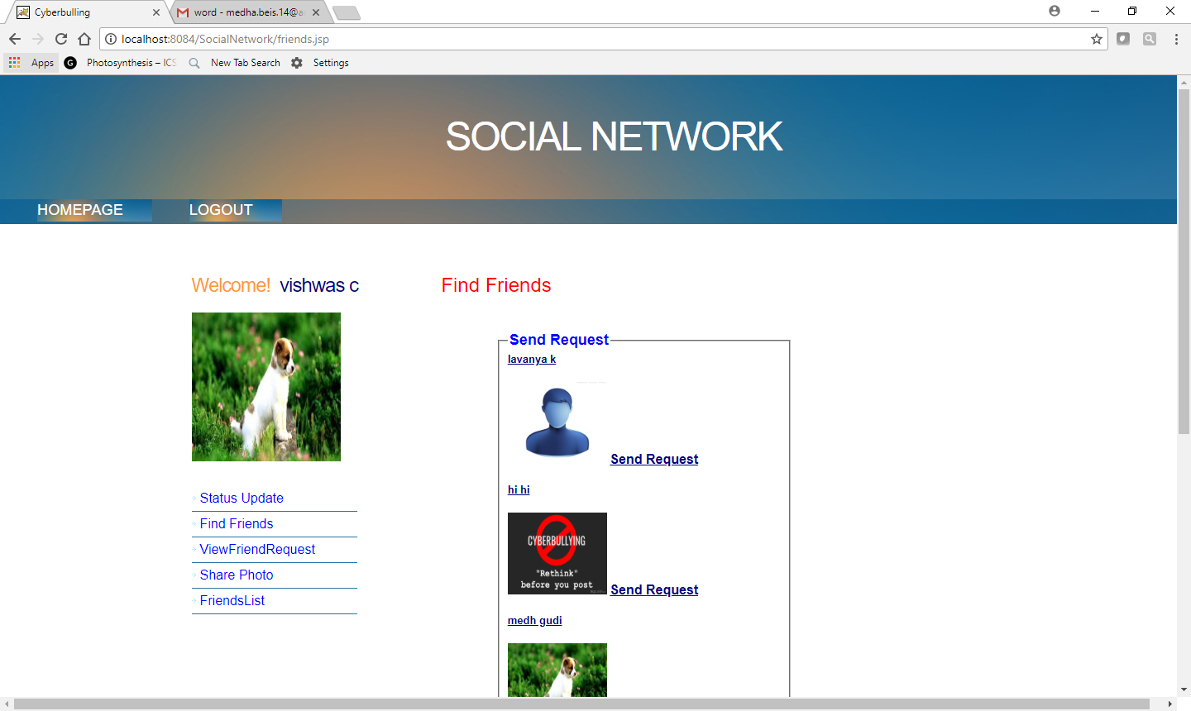
FIND FRIENDS
29

Slide 30
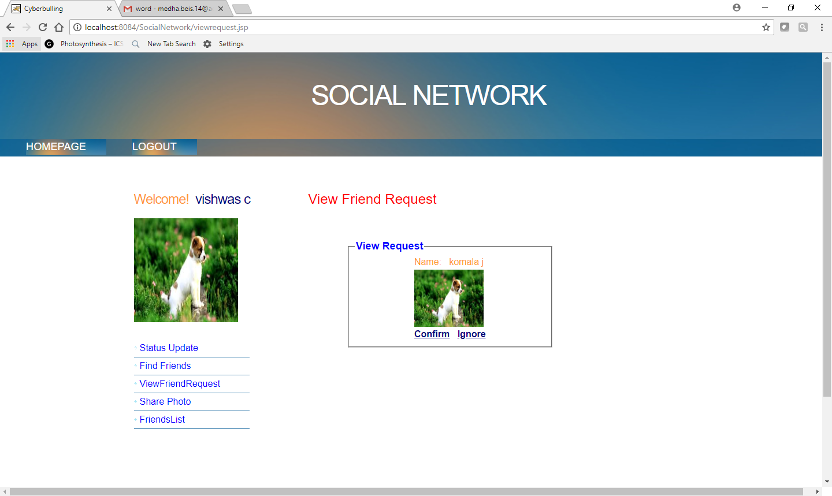
VIEW FRIEND REQUEST
30

Slide 31
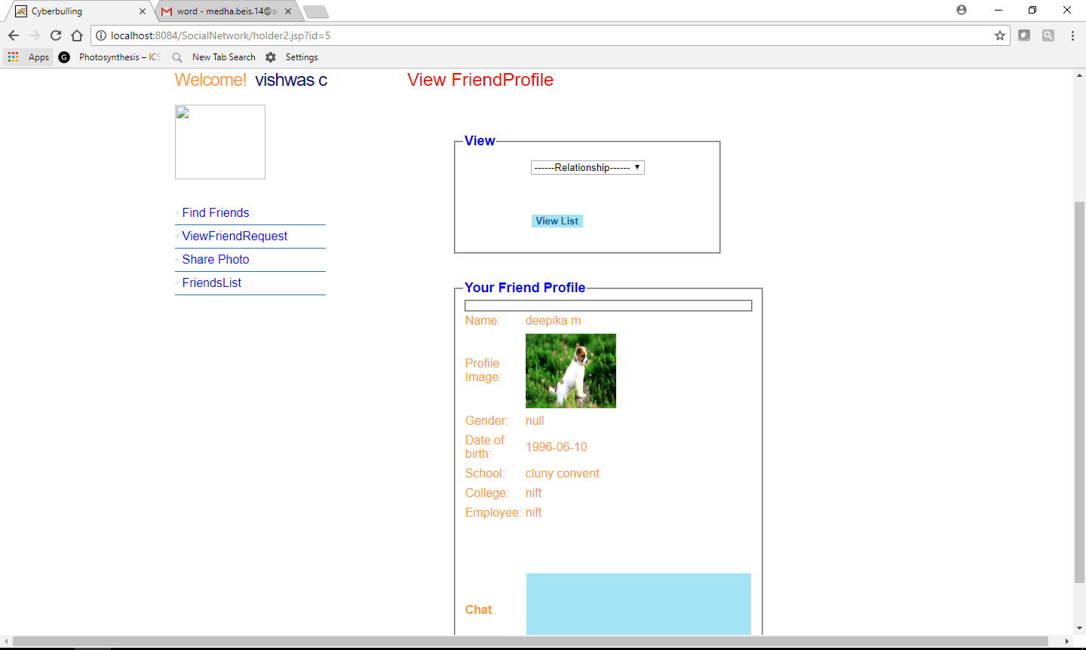
VIEW FRIEND PROFILE
31

Slide 32
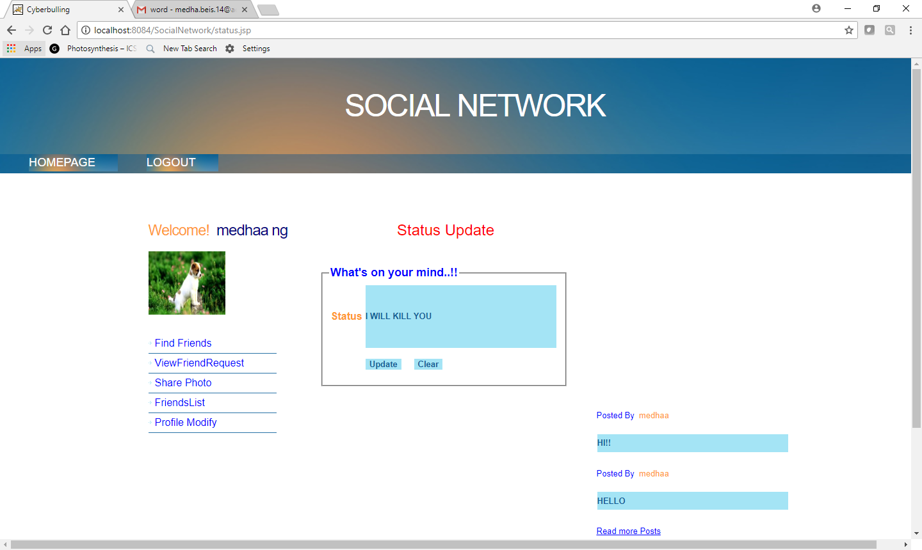
STATUS WITH A NORMAL BULLYING MESSAGE WILL BE BLOCKED
32

Slide 33

STATUS WHICH HAS HIDDEN CHARACTERS INSTEAD OF ACTUAL BULLYING MESSAGE WILL BE BLOCKED
33

Slide 34

STATUS WHICH HAS MISSPELLED WORDS INSTEAD OF ACTUAL BULLYING MESSAGE
WILL BE BLOCKED
34

Slide 35

A BULLYING USER WILL NOT BE ALLOWED TO UPDATE STATUS TEMPORARILY
35

Slide 36
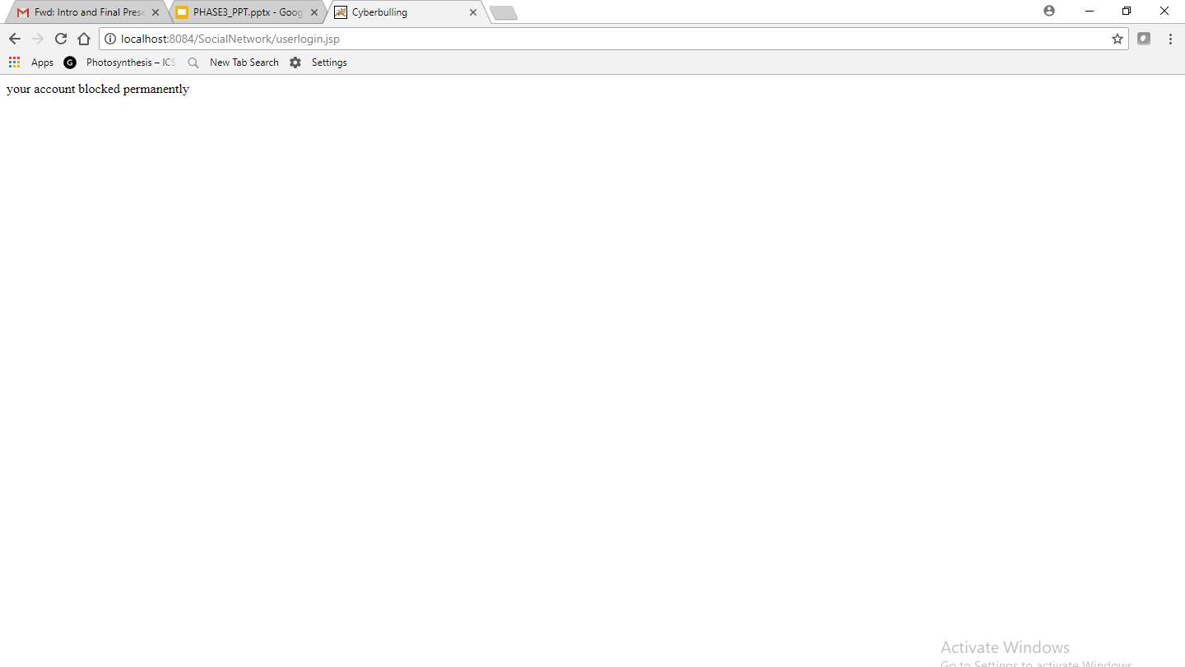
A USER WILL BE BLOCKED PERMANENTLY IF HE POSTS BULLYING MESSAGES MORE THAN TEN TIMES
36

Slide 37
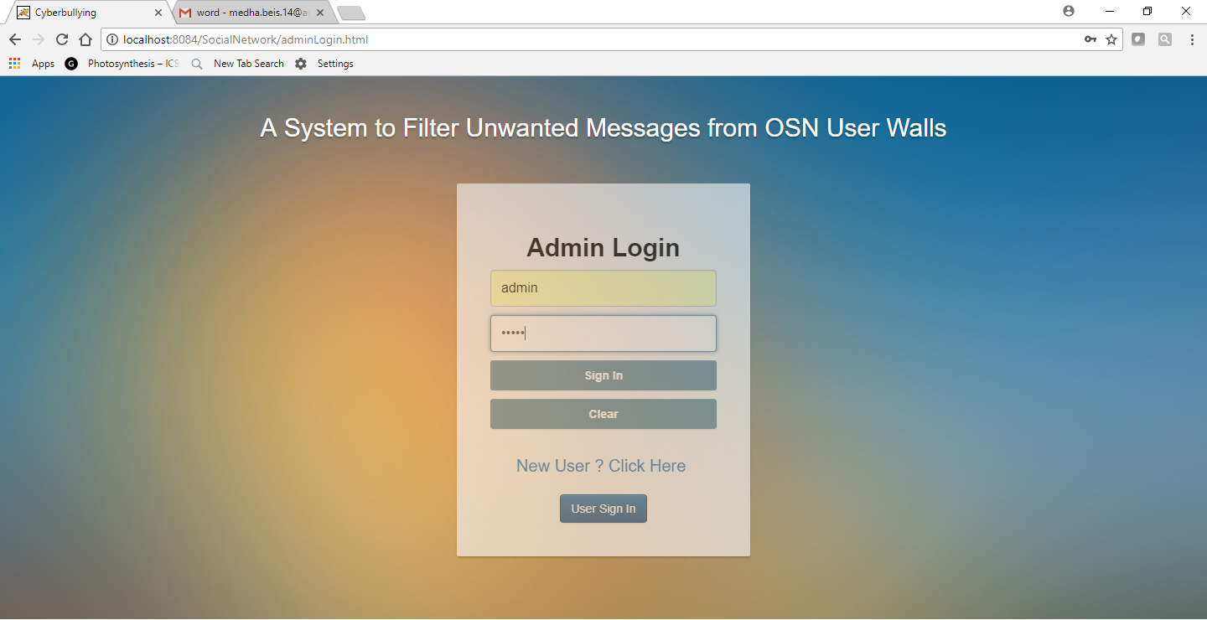
ADMIN LOGIN
37

Slide 38
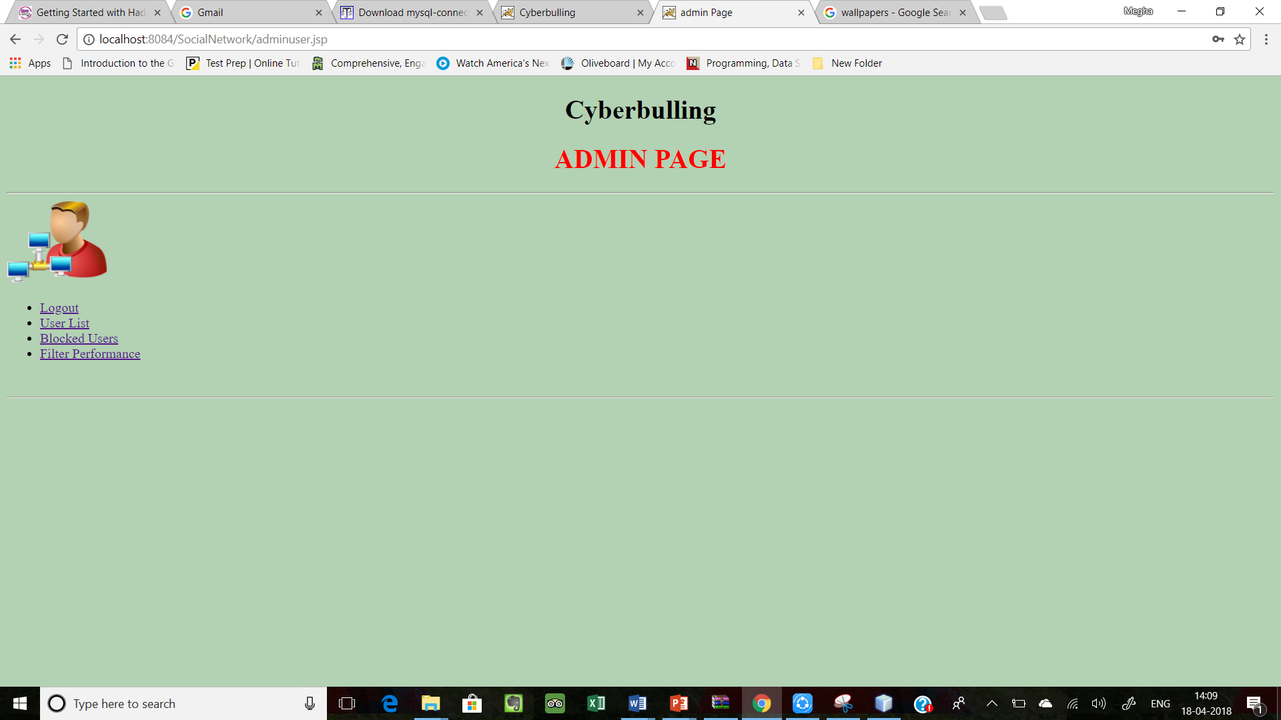
ADMIN PAGE
38

Slide 39
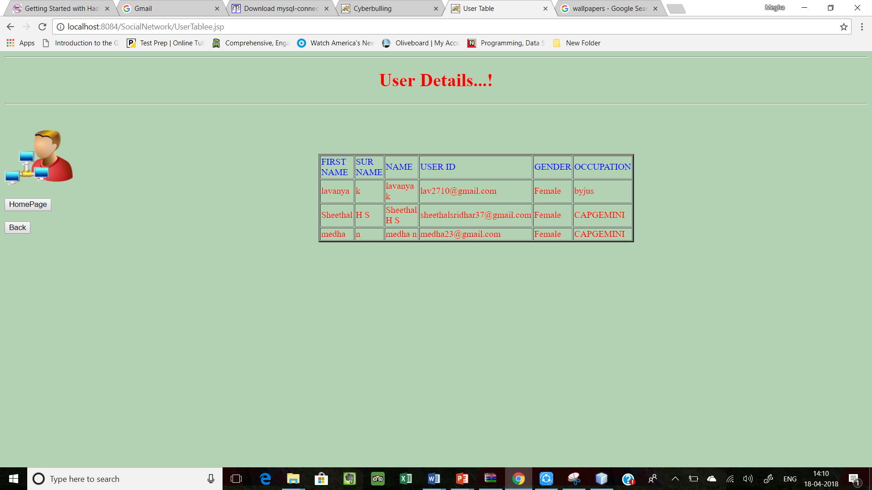
USER DETAILS
39

Slide 40
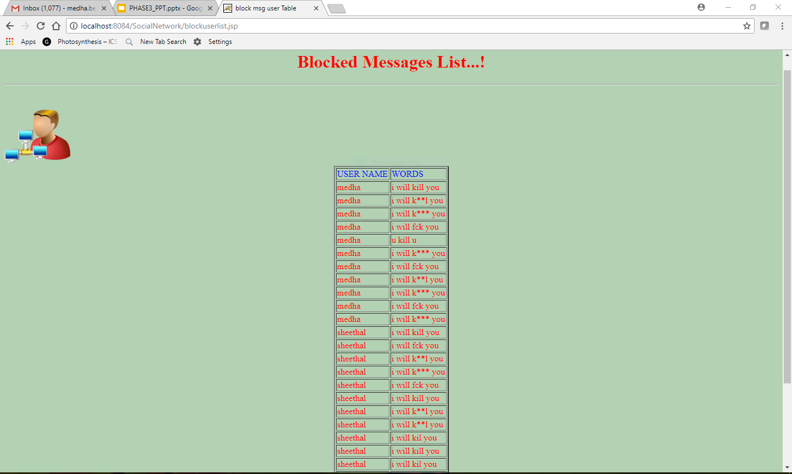
BLOCKED MESSAGES LIST
40

Slide 41
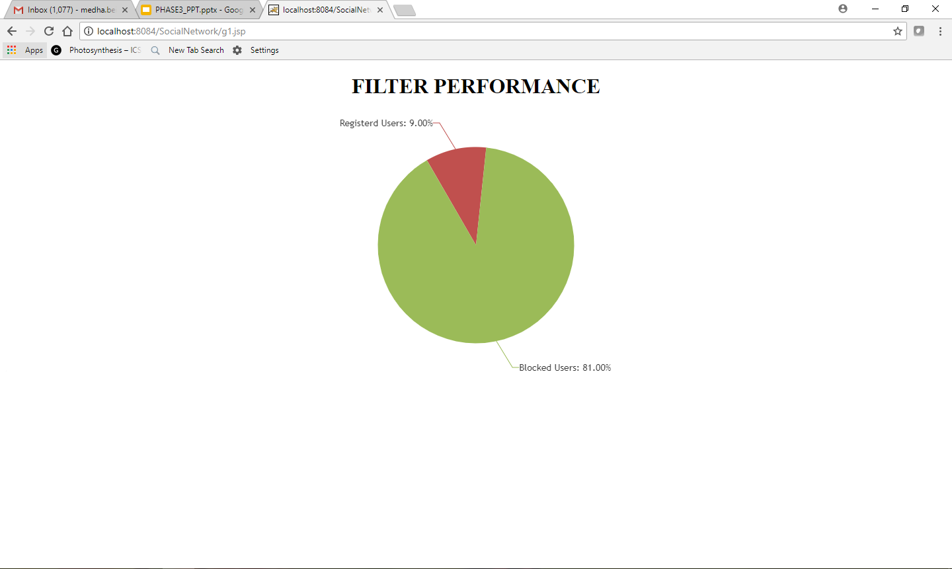
FILTER PERFORMANCE
41

Slide 42
TESTING
Unit Testing Cases
Serial Number | Components Tested | Method Used | Description | Status | Remarks
1 | Login Page | Unit Testing | Enter the user name and the password of the registered user. | Pass | Verification takes 2-3 seconds
2 | Signup Page | Unit Testing | Enter the details of the new user and thereby setup the profile for the first time. | Pass | A new profile for the user is created.
3 | Status update | Unit Testing | Enter the status to be posted. | Pass | The post is allowed if there are no bullying words or else it is blocked.
4 | Find friends | Unit Testing | View the list of registered users on the online social network. | Pass | Send friend requests to the registered users.
42

Slide 43
Serial Number | Components Tested | Method Used | Description | Status | Remarks
4 | View friend request | Unit Testing | View the list of friend requests to be confirmed or rejected. | Pass | Confirm or reject the request .
5 | Profile modify | Unit Testing | Enter the changes to be made to the profile information and change profile picture. | Pass | Changes are reflected on the users profile.
6 | Share photo | Unit Testing | Choose the image to be uploaded. | Pass | The image appears on the friends wall based on the privacy.
43

Slide 44
Integration Testing Cases
Serial Number | Components Tested | Method Used | Description | Status | Remark
1 | Login Phase | Integration Testing | Check if the user is able to login or not | Pass | Server verifies the user and sends a push notification on successful login.
2 | Signup Phase | Integration Testing | Check if the user is already existing user or not create a new profile for the user. | Pass | On successful signup the user is requested to update his profile picture and other details.
3 | Blocking Phase | Integration Testing | Check if the posts contains any bullying words. | Pass | These posts are blocked from being posted and the user is temporarily is unable to post any status updates. On persistent attempts to post the user is blocked permanently.
4 | Admin Phase | Integration Testing | Check if the admin is able to view all the user profiles. | Pass | The admin will be able to view the no of users and posts which are blocked along with the performance rate.
44

Slide 45
APPLICATIONS
Textual Cyberbullying methods used here can be applied to dynamically detect and act in the following platforms:
Social media websites like Twitter, Facebook, Youtube, Instagram etc.
Here it can detect bullying words/posts present in comments, Status updates and captions.
Discussion forums on various websites.
Various discussion forums are present on the internet wherein abusing one another is very common, Hence by using these methods we can avoid them to a certain level.
In office-inter chats and school chat rooms.
These chat rooms are limited to a certain group of people and hence the textual cyberbullying detection method can be modified to monitor cyber bullying here.
45

Slide 46
FUTURE WORK
The whole focus of the project is based on automatic detection of textual-based cyberbullying and the same has been verified with the help of a sample OSN.
The major components of today’s Social media platform is images, videos, GIF’s and various other visual posts through which bullying can occur.
Technology like image processing to extract the words from a image can be very useful.
These neglected mediums can be focussed on in the coming days.
46

Slide 47

CONCLUSION
The project aims to control cyberbullying in social media as much as possible.
Also to remove the harmful users who try to bully others from online social network.
47

Slide 48
REFERENCES
G Netaji, ”Detection based on Semantic-Enhanced Marginalized Denoising Auto-Encoder”, International Journal of Scientific Research in Computer Science, Engineering and Information Technology, 2017.
D. Yin, Z. Xue, L. Hong, B. D. Davison, A. Kontostathis, and L. Edwards, "Detection of harassment on web 2.0," Proceedings of the Content Analysis in the WEB, vol. 2, pp. 1–7, 2009.
K. Dinakar, R. Reichart, and H. Lieberman, "Modeling the detection of textual cyberbullying." in The Social Mobile Web, 2011.
V. Nahar, X. Li, and C. Pang, "An effective approach for cyberbullying detection,
" Communications in Information Science and Management Engineering, 2012.
Rui Zhao and Kezhi Mao, “Cyberbullying Detection based on Semantic-Enhanced Marginalized Denoising Auto-Encoder”, IEEE Transactions on Affective Computing, 2016.
https://goo.gl/forms/U6w7F03iLyh4XzRM2 - A Survey on Cyberbullying.
48

Slide 49

ANY QUESTIONS???
49

Slide 50

THANK YOU
50

